Slide 1
Juwita Remvik
thehandy.com
Notes:
Good afternoon. It’s great to see SO many of you here today. Thank you NFSS for inviting us to present what we’ve been working in the past 5 years and the opportunities it can give you.

Slide 2
HOW CAN I UTILIZE THIS TO HELP THE COMMUNITY?
Notes:
During this session, I’d like you to have this question at the back of your mind: how can I utilize this to help the community?
Can I have a show of hands, how many of you have heard about THE HANDY?
Yes – awesome
No – here’s what the Handy is all about

Slide 4
Established in 2018
Ohdoki AS – IoT company with focus on sextech
HQ in Oslo, Norway – 10 employees
4 satellite offices – 10 employees
Notes:
It all started in 2018 in Oslo, when our founders decided to revolutionize market by making world’s smartest and most advanced sex toys.
Satellite offices: Batam (Indonesia), Indore (India), Miami (USA), various cities (Brazil)

Slide 5
Notes:
NAV Hjelpemiddelsentral – who can help us get back in there?
Vi er norske og vi er stolte av det

Slide 6
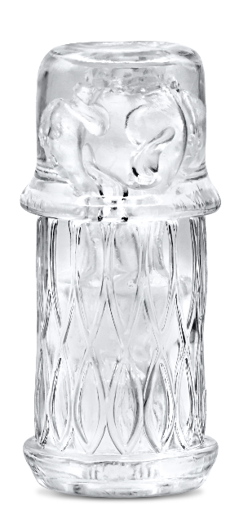
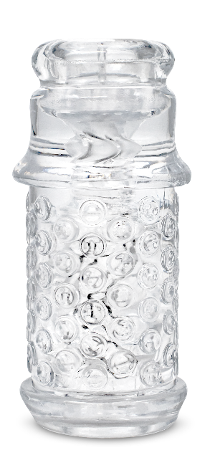
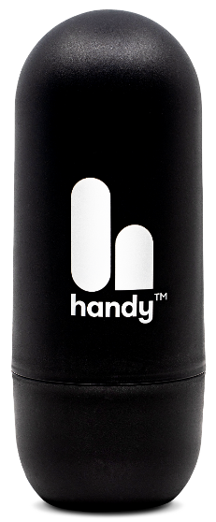
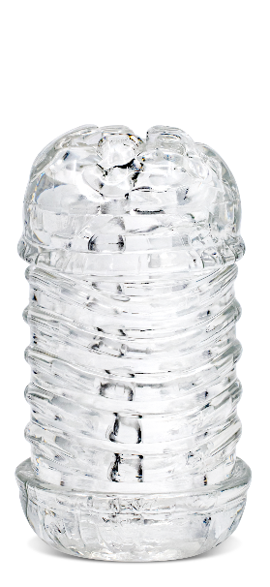
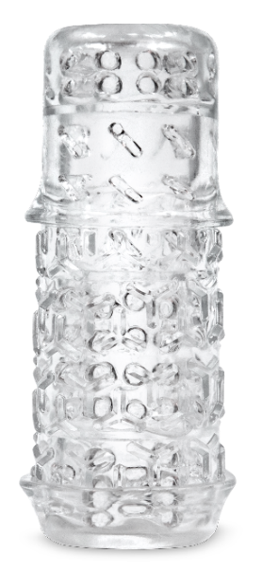
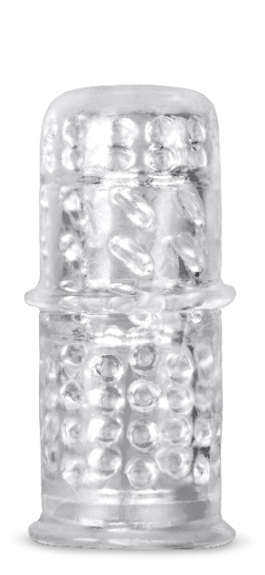
THE HANDYVERSE
^{Flagship}
^{Added value from Handy usage}
^{Peer support}
^{Hardware - Handy​}
^{Hardware - Accessories}
^{Software - Online usage}
^{Community​}
^{120.000+}
^{40.000+}
^{2m video sessions}
^{20.000+}
^{units sold globally}
^{units sold in 2023}
^{in December 2023}
^{members}
Notes:
Let me guide you through the Handyverse
Share feedback, experience, ideas

Slide 7
HOW TO USE HANDY
Notes:
Let me show you how it’s done
I can connect the device to the app and remote control it.

Slide 8
WHAT YOU SEE IS WHAT YOU FEEL
BUT WHAT IF YOU CAN’T SEE?
Notes:
What if you’re not Handy?

Slide 9
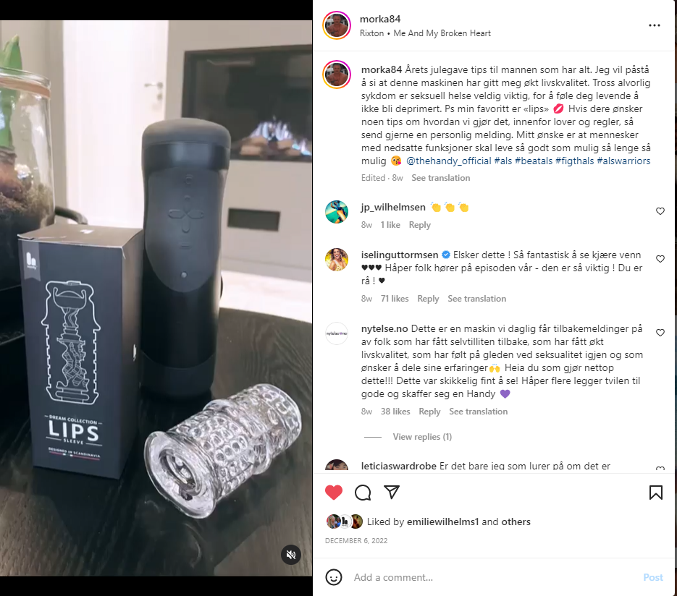
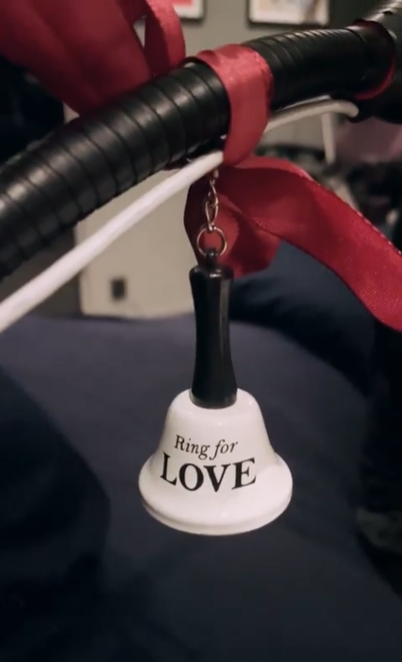
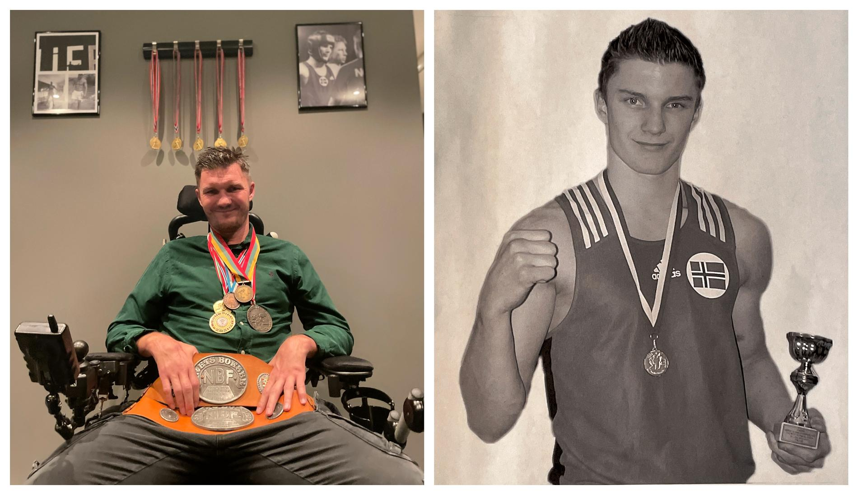
Our users
«Jeg vil påstå å si at denne maskinen har gitt meg økt livskvalitet.»
Notes:
Used to be Handy
Nils Arne Morka
35 år, ALS
Strong advocate for sexual health on social media despite his disabilities

Slide 10
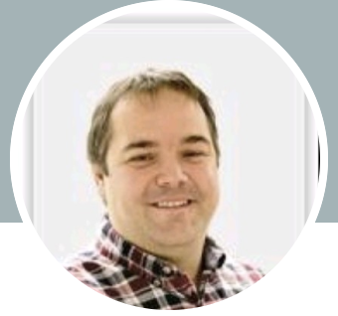
Our users
The Handy offers pleasure and possibilities like no other machine that I know of. It gives me as a user freedom and flexibility to be able to enjoy myself by myself or with my wife in ways that I thought for quite a while was lost to me. The way the machine can be used hands free, with multiple sleeves and with all its functions that the app provides it has become nearly priceless to me to own one. If I were to recommend a sexual aid for users in my situation or others that are in need of help when it comes to sexual satisfaction. I highly recommend having a look at The Handy as a unit to try because of its versatility, flexibility and endless possibilities for adjustment and combinations.
Notes:
- Bjørn
- 50 years old from Trøndelag
- Spinal injuries and wheelchair bound

Slide 11
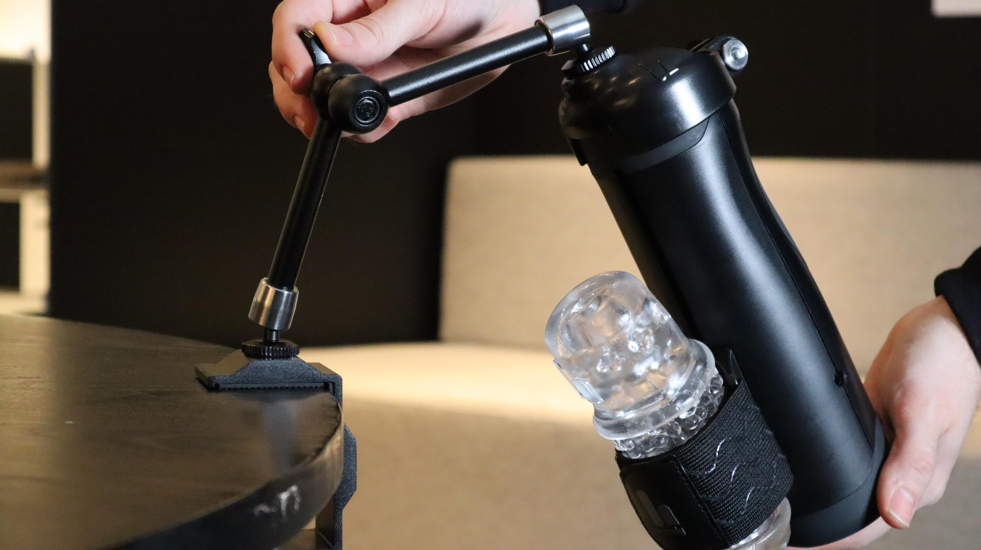
Notes:
This has completely changed the way people use the Handy

Slide 12
Health-related activities
Collaborations
Sexologist Yvonne Dolonen, Sunnaas Sykehus
Sexologist Lindsey Doe, Sexplanations (YouTube) – 400.000 views
Social Psychologist Justin Lehmiller, Kinsey Institute at Indiana University
Requests
MPower Me
Cincinnati Children’s Hospital – Fertility Care and Preservation Program
Notes:
MPower Me designs and supports personalized assistive technology for those with cognitive dissonance
Cincinnati Children’s program works with fertility preservation for those whose medical conditions place them at risk for fertility complications in the future

Slide 13
HOW CAN I UTILIZE THIS TO HELP THE COMMUNITY?

Slide 14
Opportunities
Hardware:
Sleeve variation
More robust handsfree-solution
Software, open API:
Voice control
Eye movement control
Remote control
Medical apps
Notes:
Hardware:
- Sleeves – vibrating, heating
- Flat surface – different surface, attach to wheelchair, medical beds
Open API
- we think that’s amazing
- Medical app

Slide 15
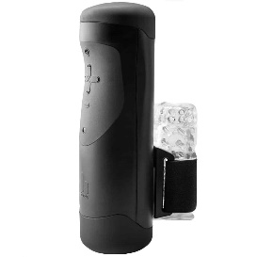
Be a part of our journey
1st Handy sold
Software
Apotera
Health
2019
2020
2022
2024
2025
Notes:
- We have the tech know-how
- You have the medical insights and expertise, understand the challenges we need to overcome
- I invite you to talk to us, and share your ideas
- Together we can find solutions
- 2025 more happy people masturbating with Handy

Slide 16
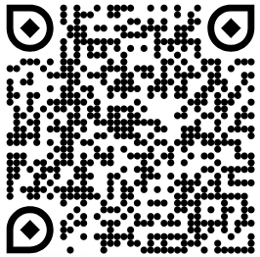
Join us!
Juwita Remvik
juwita@ohdoki.com
thehandy.com

